Slide 1
Class 7: Linear Regression 1
MGSC 310
Ben Labaschin

Slide 2
Class 7: Outline
Linear Regression Review
Estimating Linear Models in Python
Interpreting Model Coefficients
Regression Lab (Lab 7)
👈

Slide 3

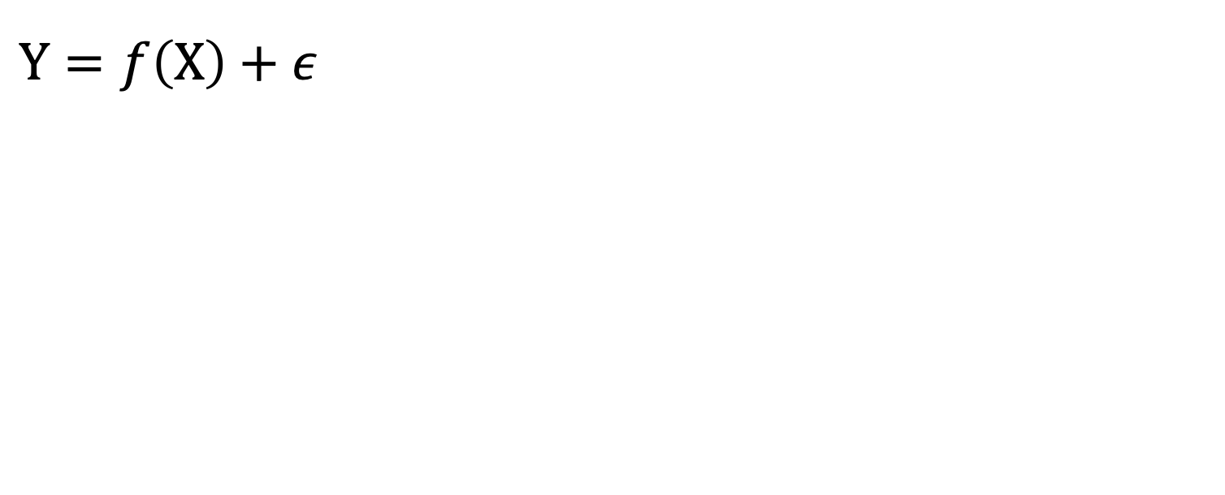



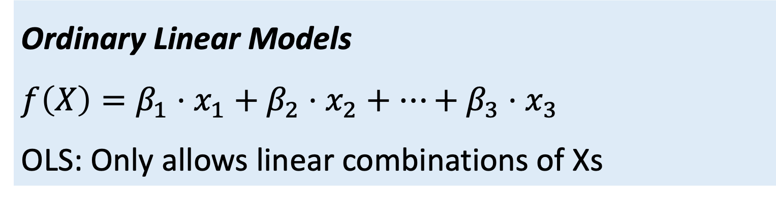
Notes:
Linear Regression simplified is an expanded version of y = mx + b

Slide 4
What is Linear Regression?
Regression: statistical process of estimating relationship between an outcome and one or more predictors or independent variables
Sales
(dependent or outcome variable)
Linear Regression: restricting relationship between predictors and outcome to be linear
Advertising
(independent variable)

Slide 5

Linear Regression Equation
Red line “explains” the data the best.
Sales
(dependent or outcome variable)
100m
Advertising
(independent variable)

Slide 6




Predictions from Linear Regression
Suppose we spend 100m on advertising?
What’s our expected sales?
Sales
(dependent or outcome variable)
Advertising
(independent variable)
100m

Slide 7




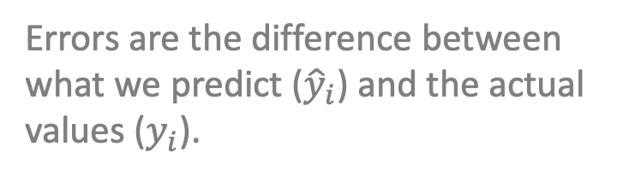
Residuals: Measure Difference Between F(x) and Y
Errors:
50
Sales
(dependent or outcome variable)
Error:
The difference between observation and prediction!
10
Advertising
(independent variable)

Slide 8
On Errors and Their Meaning
Errors:
Know this!!
Every model has error inherent to it. Some of this error has to do with true "lift" or predicitivity that is not accounted for in the mode. That is to say, we may not be including all pertinent information as independent variables in the data. Additionally, epsilon also represents the "noise", "randomness, or fundamental error that is included in our predictions as we attempt to approximate the "true" distribution of our data from our observations.

Slide 9
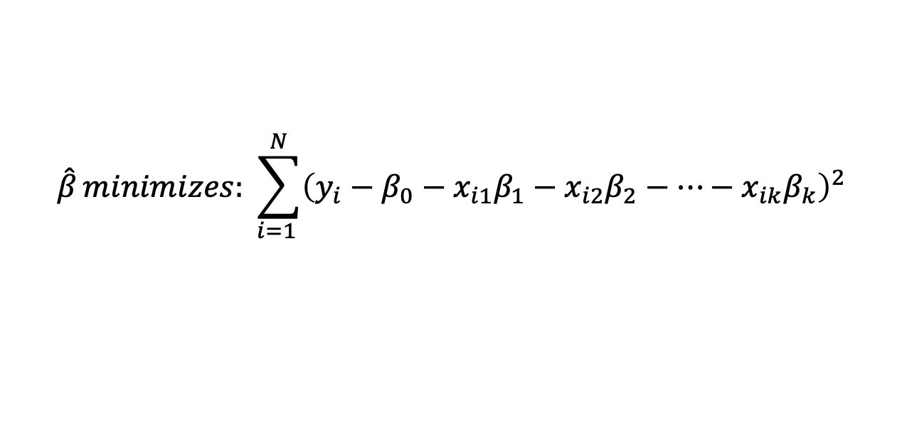
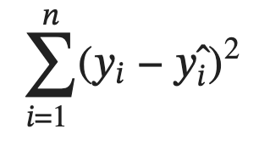
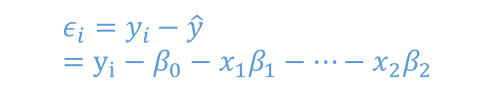
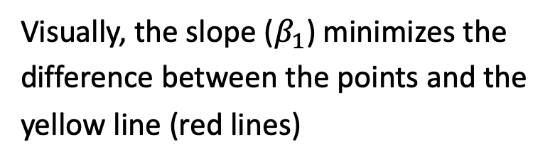
How Are Linear Regression Coefficients Chosen? Sum of Squares Error!
Know this!!
=
= Sum of Squared Errors
Least Squares Minimizes the sum of squared residuals
Sum through all observations
Beta coefficients are chosen to minimize the sum of squared errors!
Y
X

Slide 10
Class 7: Outline
Linear Regression Review
Estimating Linear Models in Python: to the code!
Interpreting Model Coefficients
Regression Lab (Lab 7)
👈

Slide 11
Estimating Linear Models in Python
To the code!

Slide 12
Class 7: Outline
Linear Regression Review
Estimating Linear Models in Python: to the code!
Interpreting Model Coefficients
Regression Lab (Lab 7)
👈

Slide 13
What Is Model Interpretability?
Model interpretability:
“the degree to which a human can understand the cause of a decision” (Miller, 2017)
The higher the interpretability, the easier it is for someone to comprehend why a decision has been made
High Interpretability Models
Linear and smooth relationships
Easy to compute
Few observations okay
Linear regression (OLS)
More interpretable
Decision Trees
Low Interpretability Models
Non-linear relationships
Non-smooth relationships
Need many observations
Long computation time
Interpretability
Random Forests
Neural Networks
Less interpretable
Deep Neural Networks
Less accurate
Accuracy
More accurate

Slide 14
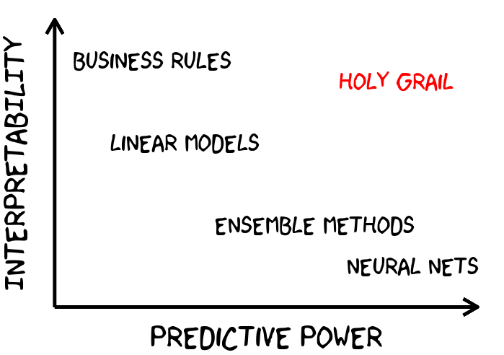
Of Course We Care About Both!

Slide 15
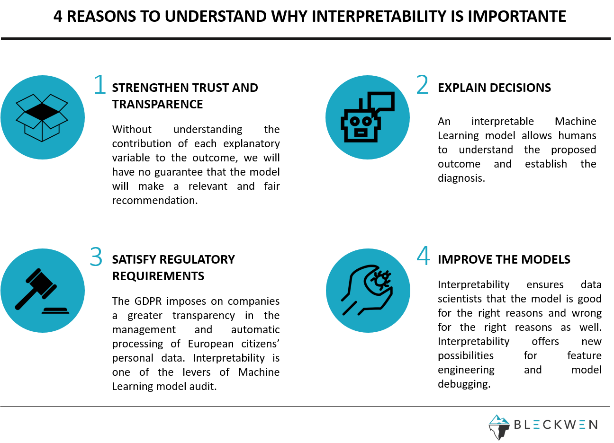
Why Do We Care About Model Interpretability?
Strengthen Trust and Transparency
People trust things they can understand, and don’t trust things they don’t (5G)
Explain decisions
An interpretable model allows humans to understand the proposed decision, and diagnose and analyzed the solution
3. Regulatory Requirements
Certain regulatory schemes (GDPR, Anti-Discrimination) require transparency.
4. Improve the models
Interpretability ensures the model is right or wrong for the right reasons. Interpretability offers new feature engineering and helps debugging.

Slide 16
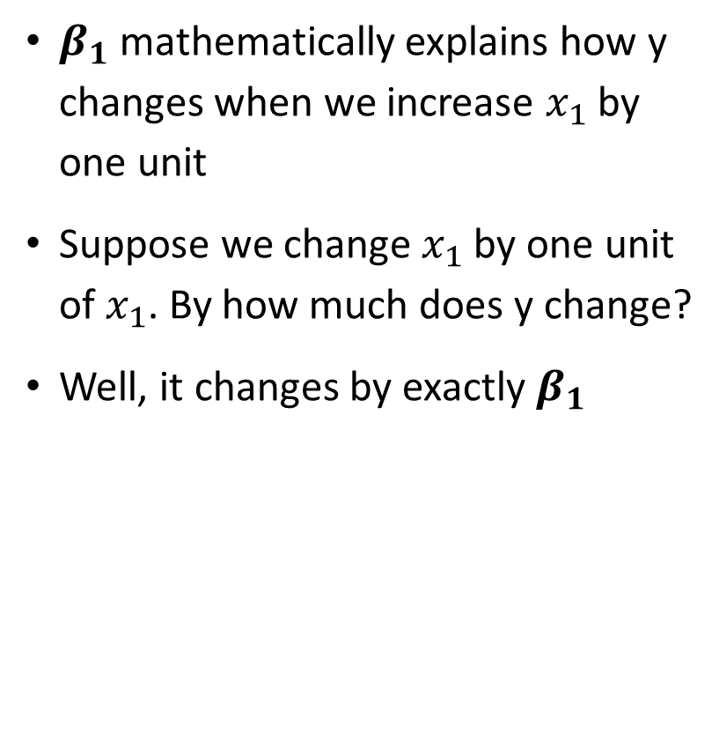
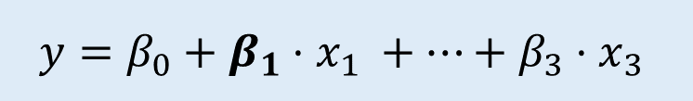
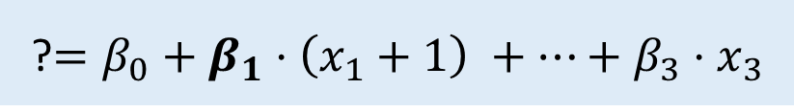






Interpreting Linear Model Coefficients

Slide 17
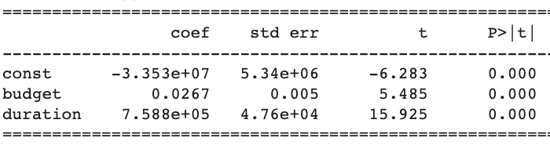
Interpreting Linear Coefficients In Words
KNOW THIS!!!
Communicating effect of coefficient Increasing budget by one dollar (communicate units!) increases gross (y variable) by 3 cents holding fixed everything else
X-variable
X-variable units
Direction (pos/neg)
Y-variable (outcome)
Estimated coefficient (magnitude)
Y-units
DO NOT JUST SAY WHEN X GOES UP Y GOES UP OR DOWN

Slide 18

Lab 7

Slide 19
Class 7 Summary
Regression estimates a relationship between an outcome (y) and one or more predictor variables (Xs)
Linear regression or OLS restricts these relationships to be linear
Model interpretability means we can easily communicate why a model makes certain choices
We should strive to build the most interpretable models whose accuracy is acceptable
To interpret a coefficient in words we must state the X variable, its units, the direction of the effect, and the magnitude of the effect in appropriate units

